Slide 1
Chemotaxis Chemical Concentration with CFD
Tim Davison
Advisors:
Dr. Nickels, Dr. Nguyen

Slide 2
Introduction
This project: Uses computational fluid dynamics to model interactions of the chemotaxis performing robot with the environment (Colloidal Lattice Boltzmann)
Model a chemical source with wind by solving advection/diffusion equations
Method computes concentration at each point in the complex environment and feeds to existing controller

Slide 3
Objectives
Understand existing CLB MATLAB code coupled with Rapid Cell
Generate solution for 2D advection/diffusion equation to output concentration with MATLAB PDE Toolbox or other, pre-existing PDE Solver
Implement solution into existing Rapid Cell code using output from LBM
Testing and validation
Document and report results

Slide 4
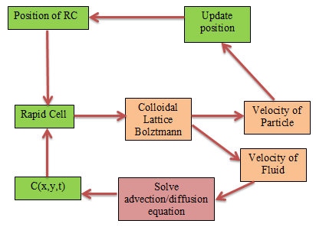

Slide 5
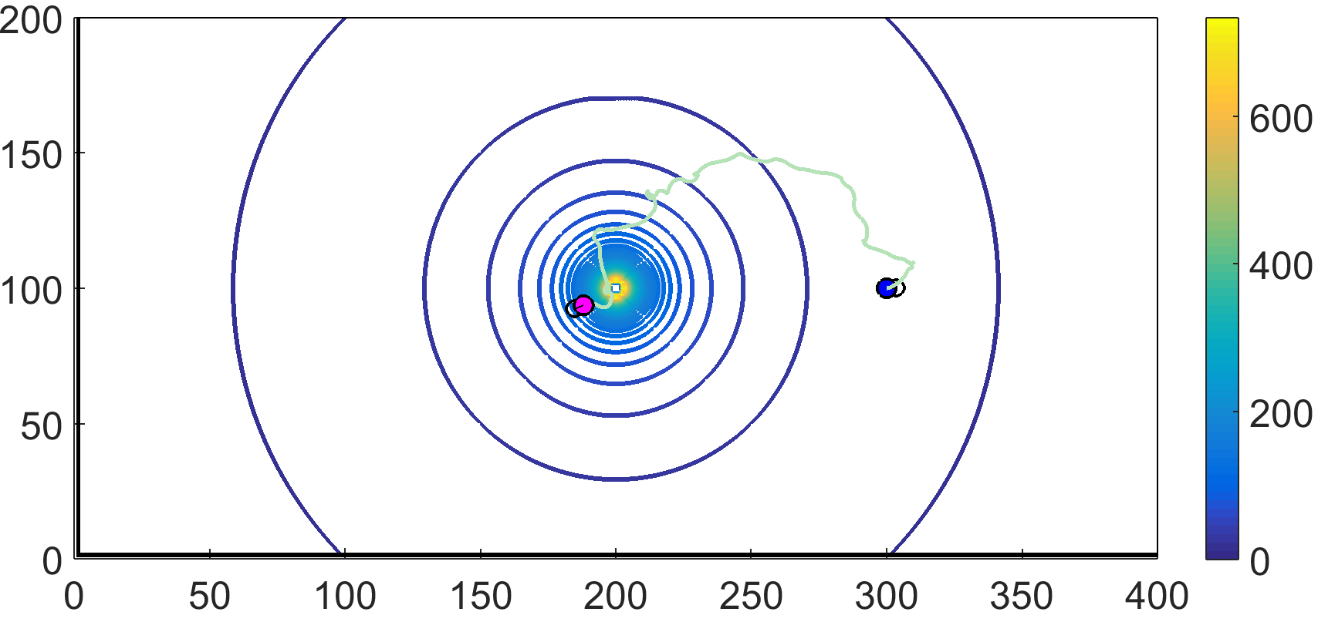
Understanding Rapid Cell/LBM Code
Looks very similar to what I have previously done

Slide 6
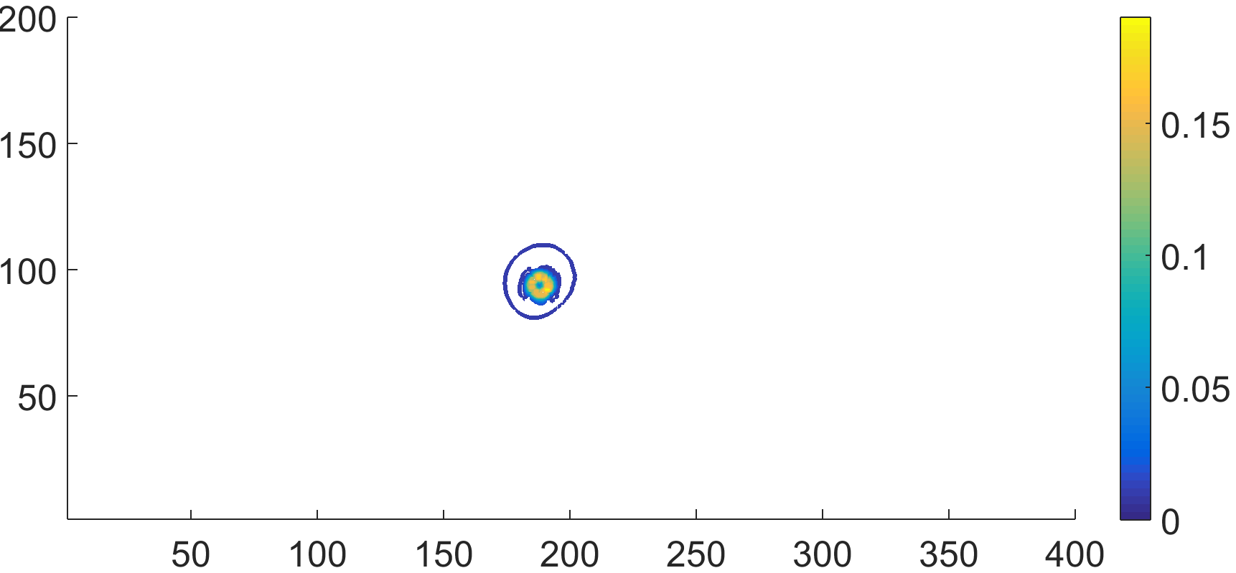
Understanding Rapid Cell/LBM Code
Differences: Velocity of fluid due to robot movements is computed
Outputs that concern me: fluid velocity field
Can include fluid flow in LBM simulation

Slide 7


Advection/Diffusion Equation
$$\frac{∂C}{∂t}=∇∙\left(D∇C\right)−∇∙\vec{v}C+ f$$
Diffusion
Advection
Source
C Concentration
D Diffusion Coefficient
$\vec{v}$ Velocity field
$∇∙$ Divergence
$∇$ Gradient

Slide 8


Assumptions
Incompressible flow over a small area of particle flow (divergence of velocity field is zero)
Constant Diffusivity (diffusion coefficient)
Two Dimensional Flow
$$\frac{∂C}{∂t}=D∇^{2}C−\vec{v}∙∇C+ f$$
$$\frac{∂C}{∂t}=D\left(\frac{∂^{2}C}{∂x^{2}}+\frac{∂^{2}C}{∂y^{2}}\right)−\vec{v}∙\left(\frac{∂C}{∂x}+\frac{∂C}{∂y}\right)+ f$$

Slide 9
Analytical Solution?
Literature search to determine if there is a pre-existing solution to this equation
Plug and chug
Exist but with simplifying assumptions
Steady state, no source, 1D advection

Slide 10
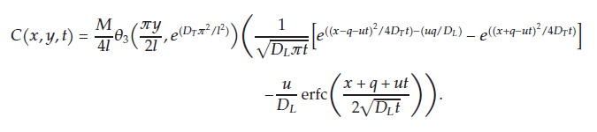
Assumes one time pulse injection
Advection in only x-direction
Our chemical → constant injection, 2D
Source: An Analytical Solution of the Advection Dispersion Equation in a Bounded Domain and Its Application to Laboratory Experiments

Slide 11


PDE Toolbox
$$\frac{∂C}{∂t}=D\left(\frac{∂^{2}C}{∂x^{2}}+\frac{∂^{2}C}{∂y^{2}}\right)−\vec{v}∙\left(\frac{∂C}{∂x}+\frac{∂C}{∂y}\right)+ f$$
This equation can be solved with some PDE toolbox manipulation
Problem: Cannot input vector field into PDE toolbox
$$\left(\begin{matrix}C_{1} \\ C_{2}\end{matrix}\right)$$

Slide 12
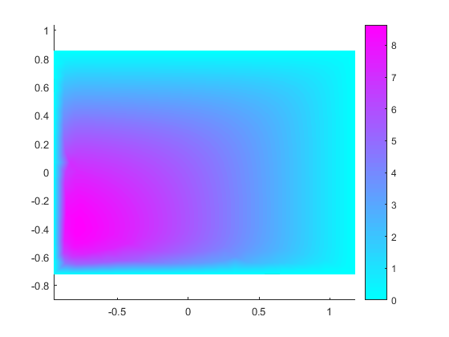
PDE Toolbox

Slide 13
PDE Toolbox
Future solution:
Use PDE toolbox in a script file
More freedom/manipulation
Input vector field and use PDE Toolbox’s numerical techniques to solve for C(x,y,t)
Output this function to LBM/Rapid Cell and run simulations
If it doesn’t work → use a different solver
OR: implement analytical solution and assume 1D advection ☹

